Slide 1

DEPARTMENT OF COMPUTER SCIENCE & ENGINEERING
SCHOOL OF COMPUTING
1156CS701- MAJOR PROJECT
WINTER SEMESTER 2023-2024
INTERNSHIP THROUGH DIND
ENCORA PVT.LTD
REVIEW - II
“CYBER HACKING BREACHES PREDCTION USING
MACHINE LEARNING”
SUPERVISED BY
DR.P.J.BESLIN PAJILA
PRESENTED BY
1. NALLURI KARTHIK (VTU15337)(20UECS0659)
2. KOTA MANISH (VTU17731)(20UECS0501)

Slide 2
INDUSTRY DETAILS
Industry Name/Institute Name-Encora Pvt.Ltd
Duration of Internship (From Jan 17 – To May 17)
Duration of Internship in Months-4 Months
Industry Guide Name- Anuhya Reddy
Industry Guide Mobile No-9885488485
Industry Guide Mail ID-encoraanuhya@gmail.com
Industry Address- Pallavaram -Thoraipakkam Road, Chennai,
Tamil Nadu- 600097
8. Project Completion Status as of now(In-Progress)

Slide 3
AGENDA
ABSTRACT
OBJECTIVE
INTRODUCTION
LITERATURE REVIEW (SOFT COPY OF PAPERS TO BE LINKED AS HYPERLINK)
DESIGN AND METHODOLOGIES
IMPLEMENTATION
TESTING
INPUT AND OUTPUT
INCLUDE DEMO VIDEO-1 (Till REVEW-1)
INCLUDE DEMO VIDEO-2(Complete Implementation of Project)
CONCLUSION
WEB REFERENCES LINK(TILL REVIEW DATE ALL LINKS TO BE INCLUDED DAY WISE)
INCLUDE YOUR 2 PHOTOS OF YOUR INDUSTRY WORKING ENVIRONMENT
PLAGIARISM REPORT OF PPT
REFERENCES

Slide 4
ABSTRACT
The rapid evolution of cyber threats necessitates proactive measures to anticipate and mitigate potential breaches. In this study, we employ machine learning algorithms including Decision Tree, Random Forest, AdaBoost, Logistic Regression, KNN, and SVC to forecast cyber hacking breaches. By analyzing historical data and identifying patterns indicative of potential security breaches, these algorithms enable proactive decision-making and resource allocation for cybersecurity defenses. Through rigorous evaluation and comparison of these algorithms, we aim to determine the most effective approach for predicting cyber hacking breaches. This research contributes to enhancing cybersecurity strategies by providing insights into the predictive capabilities of various machine learning techniques. By leveraging predictive analytics, organizations can strengthen their defenses, detect vulnerabilities, and preemptively thwart cyber threats, ultimately safeguarding sensitive information and preserving operational integrity in an increasingly digital landscape.

Slide 5
OBJECTIVES
Aim
Develop a robust machine learning model to analyze historical cyber hacking incidents, aiming to predict and identify potential future breaches based on patterns and trends.Enhance cybersecurity preparedness by leveraging predictive analytics, enabling organizations to proactively address vulnerabilities and mitigate risks associated with cyber hacking threats.
Scope of the project
The project scope encompasses assessing existing cybersecurity measures, identifying vulnerabilities, implementing security enhancements, conducting user awareness training, and establishing continuous monitoring protocols. It aims to fortify digital systems and data protection against cyber hacking breaches.

Slide 6
INTRODUCTION
The advent of the digital age has ushered in unprecedented opportunities for connectivity and innovation. However, it has also given rise to a growing menace – cyber hacking breaches. In recent years, cyberattacks have become increasingly sophisticated and devastating, posing a significant threat to individuals, businesses, and even nations.This project aims to comprehensively investigate and analyze cyber hacking breaches that occurred in the past year. We will delve into the methods, motivations, and impacts of these breaches to gain a deeper understanding of the evolving landscape of cyber threats. By examining a range of high-profile cases, we intend to identify common vulnerabilities and attack vectors.Our objectives include mapping the tactics employed by hackers, assessing the effectiveness of security measures, and evaluating the financial and reputational costs incurred by victims. Additionally, we will explore the ethical, legal, and regulatory aspects surrounding cyberattacks and data breaches.This research not only serves as a valuable resource for cybersecurity professionals but also contributes to raising awareness among individuals and organizations about the importance of robust digital security. By shedding light on the ever-evolving world of cyber hacking breaches, we aim to empower stakeholders to fortify their defenses and safeguard their digital assets in an increasingly interconnected world.

Slide 7
LITERATURE REVIEW
[1] Kwon, Cheolhyeon, Weiyi Liu, and Inseok Hwang. “Security analysis for cyber-physical systems against stealthy deception attacks.” In 2013 American control conference, IEEE (2013): 3344-3349
The security issue in the state estimation problem is investigated for a networked control system (NCS). The communication channels between the sensors and the remote estimator in the NCS are vulnerable to attacks from malicious adversaries. The false data injection attacks are considered. The aim of this paper to find the so-called insecurity conditions under which the estimation system is insecure in the sense that there exist malicious attacks that can bypass the anomaly detector but still lead to unbounded estimation errors. In particular, a new necessary and sufficient condition for the insecurity is derived in the case that all communication channels are compromised by the adversary. Moreover, a specific algorithm is proposed for generating attacks with which the estimation system is insecure. Furthermore, for the insecure system, a system protection scheme through which only a few (rather than all) communication channels require protection against false data injection attacks is proposed. A simulation example is utilized to demonstrate the effectiveness of the proposed conditions/algorithms in the secure estimation problem for a flight vehicle.

Slide 8
LITERATURE REVIEW
[2] Pajic, Miroslav, James Weimer, Nicola Bezzo, Oleg Sokolsky, George J. Pappas, and Insup Lee. “Design and implementation of attack-resilient cyberphysical systems: With a focus on attack-resilient state estimators.” IEEE Control Systems Magazine 37, no. 2 (2017): 66-81.
Recent years have witnessed a significant increase in the number of security-related incidents in control systems. These include high-profile attacks in a wide range of application domains, from attacks on critical infrastructure, as in the case of the Maroochy Water breach [1], and industrial systems (such as the StuxNet virus attack on an industrial supervisory control and data acquisition system [2], [3] and the German Steel Mill cyberattack [4], [5]), to attacks on modern vehicles [6]-[8]. Even high-assurance military systems were shown to be vulnerable to attacks, as illustrated in the highly publicized downing of the RQ-170 Sentinel U.S. drone [9]-[11]. These incidents have greatly raised awareness of the need for security in cyberphysical systems (CPSs), which feature tight coupling of computation and communication substrates with sensing and actuation components. However, the complexity and heterogeneity of this next generation of safety-critical, networked, and embedded control systems have challenged the existing design methods in which security is usually consider as an afterthought.

Slide 9
LITERATURE REVIEW
[3] Sheng, Long, Ya-Jun Pan, and Xiang Gong. “Consensus formation control for a class of networked multiple mobile robot systems.” Journal of Control Science and Engineering 2012 (2012).
Embedded computational resources in autonomous robotic vehicles are becoming more abundant and have enabled improved operational effectiveness of cooperative robotic systems in civilian and military applications. Compared to autonomous robotic vehicles that operate single tasks, cooperative teamwork has greater efficiency and operational capability. Multirobotic vehicle systems have many potential applications, such as platooning of vehicles in urban transportation, the operation of the multiple robots, autonomous underwater vehicles, and formation of aircrafts in military affairs [1–3]. The study of group behaviors for multirobot systems is the main objective of the work. Group cooperative behavior signifies that individuals in the group share a common objective and action according to the interest of the whole group. Group cooperation can be efficient if individuals in the group coordinate their actions well. Each individual can coordinate with other individuals in the group to facilitate group cooperative behavior in two ways, named local coordination and global coordination. For the local coordination, individuals react only to other individuals that are close, such as fish engaged in a school.

Slide 10
LITERATURE REVIEW
[4] Zeng, Wente, and Mo-Yuen Chow. “Resilient distributed control in the presence of misbehaving agents in networked control systems.” IEEE transactions on cybernetics 44, no. 11 (2014): 2038-2049.
In this paper, we study the problem of reaching a consensus among all the agents in the networked control systems (NCS) in the presence of misbehaving agents. A reputation-based resilient distributed control algorithm is first proposed for the leader-follower consensus network. The proposed algorithm embeds a resilience mechanism that includes four phases (detection, mitigation, identification, and update), into the control process in a distributed manner. At each phase, every agent only uses local and one-hop neighbors' information to identify and isolate the misbehaving agents, and even compensate their effect on the system. We then extend the proposed algorithm to the leaderless consensus network by introducing and adding two recovery schemes (rollback and excitation recovery) into the current framework to guarantee the accurate convergence of the well-behaving agents in NCS. The effectiveness of the proposed method is demonstrated through case studies in multirobot formation control and wireless sensor networks.

Slide 11
LITERATURE REVIEW
[5] Sun, Hongtao, Chen Peng, Taicheng Yang, Hao Zhang, and Wangli He. “Resilient control of networked control systems with stochastic denial of service attacks.” Neurocomputing 270 (2017): 170-177.
This paper focuses on resilient control of networked control systems (NCSs) under the denial of service (DoS) attacks which is characterized by a Markov process. Firstly, the packets dropout are modeled as Markov process according to the game between attack strategies and defense strategies. Then, an NCS under such game results is modeled as a Markovian jump linear system and four theorems are proved for the system stability analysis and controller design. Finally, a numerical example is used to illustrative the application of these theorems. Networked control systems (NCSs) have received an increasing attention in the past decades. Now, NCSs have been widely applied in industrial processes, electric power networks, intelligent transportation and so on. With the growing of the NCSs, network, as a critical element in an NCS, is vulnerable to cyber-threats which can menace the control systems.

Slide 12
LITERATURE REVIEW
[6] M. Eling and W. Schnell, “What can we realize cyber risk and cyber risk insurance?” J. Risk Finance, vol. 17, no. 5, pp. 474–491, 2016.
The literature by Eling and Schnell (2016) explores the intricate landscape of cyber risk and cyber risk insurance, providing valuable insights into this rapidly evolving field. The authors delve into the realization of cyber risk, offering a comprehensive analysis that spans issues such as identification, assessment, and mitigation strategies. The study, featured in the Journal of Risk Finance, is particularly noteworthy for its emphasis on the dynamic nature of cyber threats and the corresponding challenges in developing effective insurance mechanisms. Eling and Schnell contribute significantly to the scholarly discourse by addressing key facets of cyber risk management, ultimately shedding light on the complexities associated with safeguarding organizations against cyber threats. The paper is a seminal resource for scholars, practitioners, and policymakers seeking a deeper understanding of the evolving landscape of cyber risk and the critical role of insurance in managing such risks.

Slide 13
DESIGN AND METHODOLOGIES
MODULE 1
Take the Dataset: The system accepts and processes the dataset provided by the user. This dataset forms the foundation for building the predictive model.
MODULE 2
Preprocessing: Before training a predictive model, the system preprocesses the dataset. This includes handling missing data, data cleaning, and feature extraction. Preprocessing ensures that the data is in a suitable format for modeling.
MODULE 3
Training: The system uses machine learning techniques and Python modules to train a model based on the preprocessed dataset. The model learns patterns and relationships within the data, allowing it to make predictions.
MODULE 4
Generate Results: Once the model is trained, the system can generate results based on user input values. These results typically indicate whether the input data corresponds to a specific condition, event, or prediction, such as detecting predict the type of Disease.

Slide 14
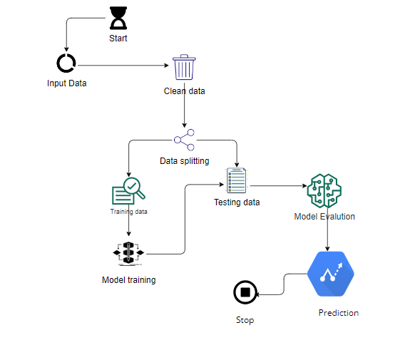
IMPLEMENTATION
ARCHITECTURE DIAGRAM

Slide 15
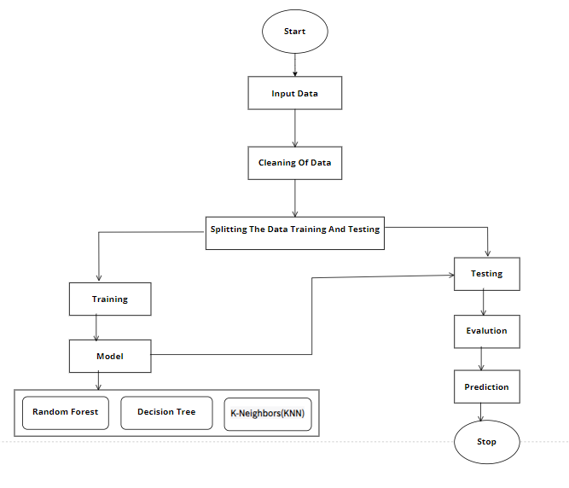
DATA FLOW DIAGRAM

Slide 16
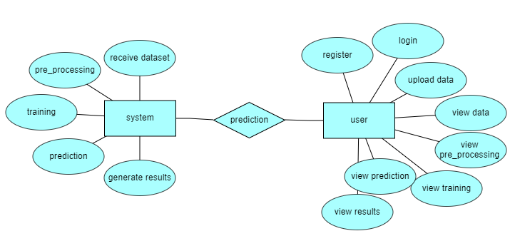
ER DIAGRAM

Slide 17
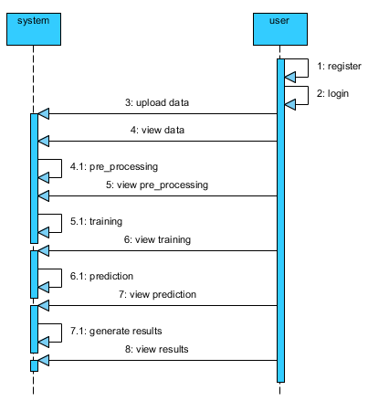
SEQUENCE DIAGRAM

Slide 18
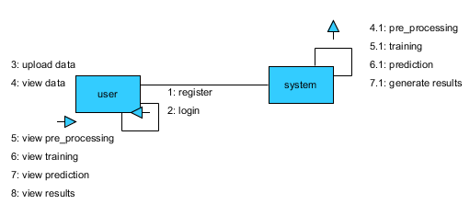
COLLABRATION DIAGRAM

Slide 19
TESTING
UNIT TESTING
Unit testing involves the design of test cases that validate that the internal program logic is functioning properly, and that program inputs produce valid outputs. All decision branches and internal code flow should be validated. It is the testing of individual software units of the application .it is done after the completion of an individual unit before integration. This is a structural testing, that relies on knowledge of its construction and is invasive. Unit tests perform basic tests at component level and test a specific business process, application, and/or system configuration. Unit tests ensure that each unique path of a business process performs accurately to the documented specifications and contains clearly defined inputs and expected results.

Slide 20
INTEGRATION TESTING
Integration tests are designed to test integrated software components to determine if they actually run as one program. Testing is event driven and is more concerned with the basic outcome of screens or fields. Integration tests demonstrate that although the components were individually satisfaction, as shown by successfully unit testing, the combination of components is correct and consistent. Integration testing is specifically aimed at exposing the problems that arise from the combination of components.
Software integration testing is the incremental integration testing of two or more integrated software components on a single platform to produce failures caused by interface defects.
The task of the integration test is to check that components or software applications, e.g. components in a software system or – one step up – software applications at the company level – interact without error.

Slide 21
FUNCTIONAL TESTING
Functional tests provide systematic demonstrations that functions tested are available as specified by the business and technical requirements, system documentation, and user manuals.
Functional testing is centered on the following items:
Valid Input : identified classes of valid input must be accepted.
Invalid Input : identified classes of invalid input must be rejected.
Functions : identified functions must be exercised.
Output : identified classes of application outputs must be exercised.
Systems/Procedures: interfacing systems or procedures must be invoked.
Organization and preparation of functional tests is focused on requirements, key functions, or special test cases. In addition, systematic coverage pertaining to identify Business process flows; data fields, predefined processes, and successive processes must be considered for testing. Before functional testing is complete, additional tests are identified and the effective value of current tests is determined.

Slide 22
White Box Testing
White Box Testing is a testing in which in which the software tester has knowledge of the inner workings, structure and language of the software, or at least its purpose. It is purpose. It is used to test areas that cannot be reached from a black box level.
Black Box Testing
Black Box Testing is testing the software without any knowledge of the inner workings, structure or language of the module being tested. Black box tests, as most other kinds of tests, must be written from a definitive source document, such as specification or requirements document, such as specification or requirements document. It is a testing in which the software under test is treated, as a black box .you cannot “see” into it. The test provides inputs and responds to outputs without considering how the software works.

Slide 23
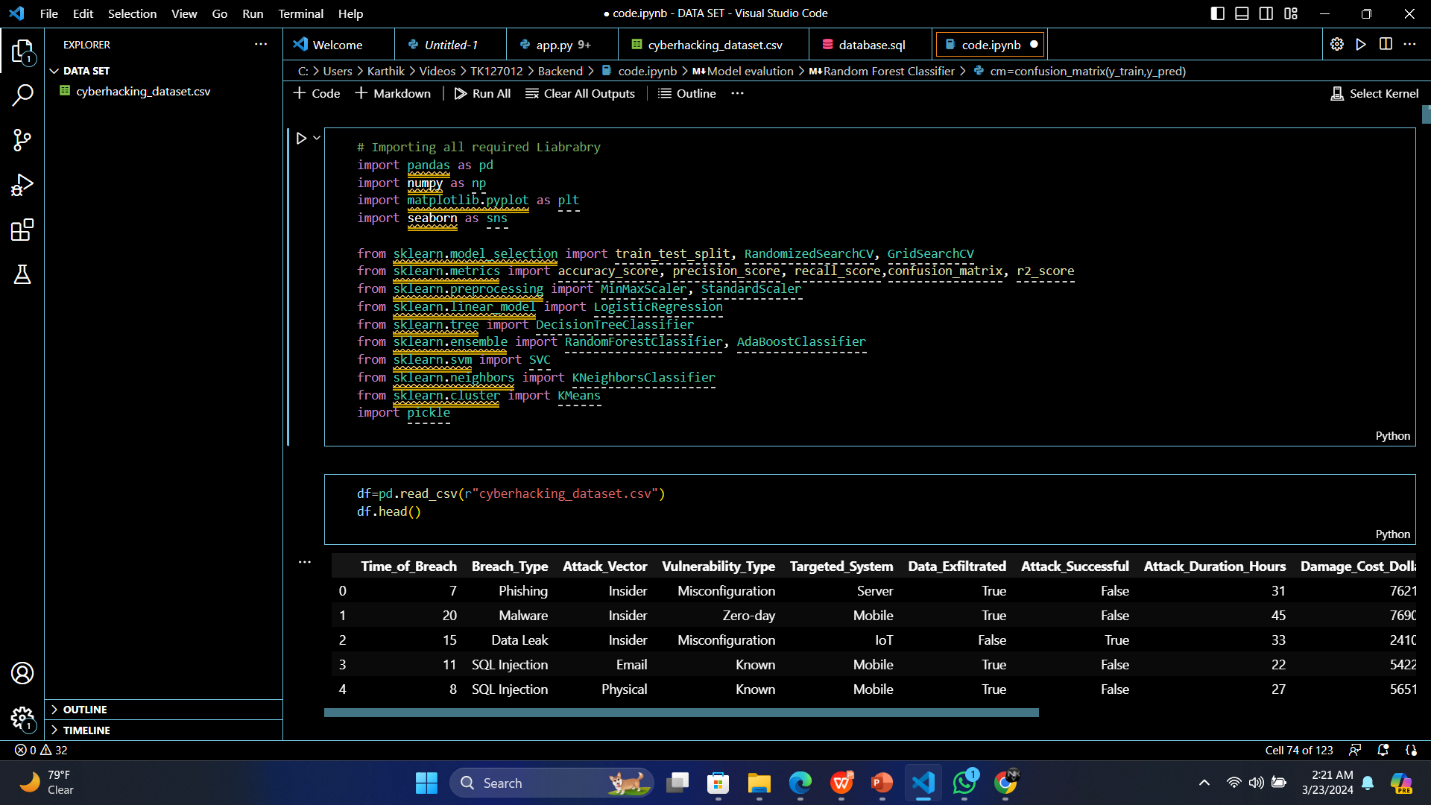
INPUT
SCREENSHOTS

Slide 24
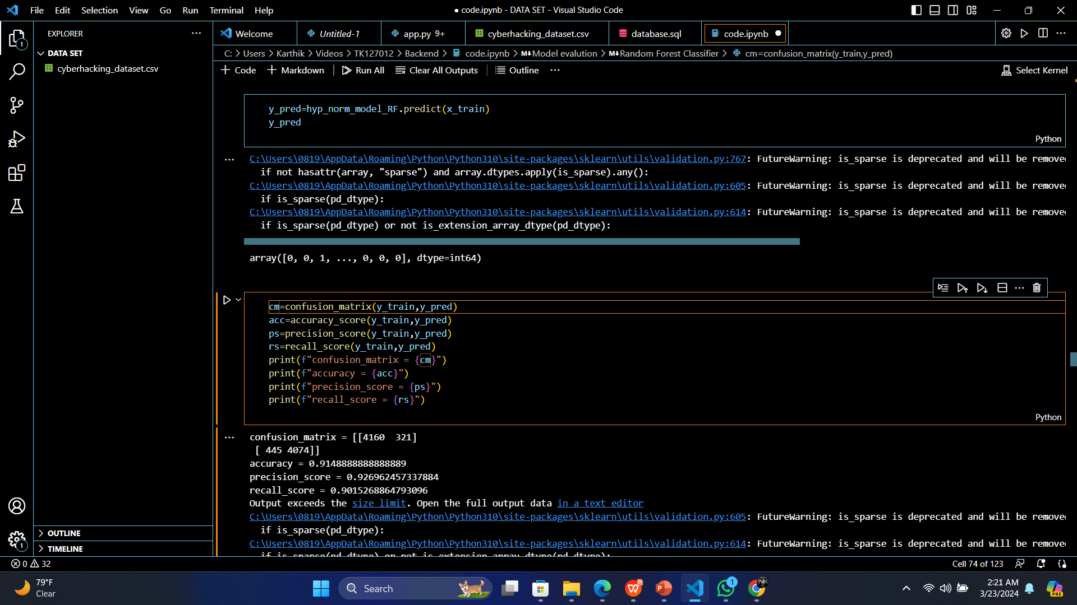
OUTPUT

Slide 25
CONCLUSION
The conclusion of the proposed approach for cyber hacking breaches prediction lies in its innovative utilization of machine learning algorithms to proactively identify and forecast potential cyber threats. Unlike traditional methods, this framework leverages advanced data analytics to discern subtle patterns and anomalies within vast datasets, enabling early detection of potential hacking breaches. The integration of machine learning models empowers the system to adapt and evolve with emerging cyber threats, enhancing its predictive capabilities. This novel approach not only contributes to the field of cybersecurity but also establishes a proactive and dynamic paradigm for anticipating and mitigating cyber risks, thus fortifying the resilience of digital ecosystems.

Slide 26

Plagiarism Report of PPT

Slide 27
REFERENCES(as per IEEE format only)
[1] Kwon, Cheolhyeon, Weiyi Liu, and Inseok Hwang. ”Security analysis for cyber-physical systems against stealthy deception attacks.” In 2013 American control conference, IEEE (2013): 3344-3349.
[2] Pajic, Miroslav, James Weimer, Nicola Bezzo, Oleg Sokolsky, George J. Pappas, and Insup Lee. ”Design and implementation of attack-resilient cyberphysical systems: With a focus on attack-resilient state estimators.” IEEE Control Systems Magazine 37, no. 2 (2017): 66-81.
[3] Sheng, Long, Ya-Jun Pan, and Xiang Gong. ”Consensus formation control for a class of networked multiple mobile robot systems.” Journal of Control Science and Engineering 2012 (2012).
[4] Zeng, Wente, and Mo-Yuen Chow. ”Resilient distributed control in the presence of misbehaving agents in networked control systems.” IEEE transactions on cybernetics 44, no. 11 (2014): 2038-2049.
[5] Sun, Hongtao, Chen Peng, Taicheng Yang, Hao Zhang, and Wangli He. ”Resilient control of networked control systems with stochastic denial of service attacks.” Neurocomputing 270 (2017): 170-177.

Slide 28
[6] Zhang, Haotian, and Shreyas Sundaram. ”Robustness of information diffusion algorithms to locally bounded adversaries.” In 2012 American Control Conference (ACC), IEEE (2012): 5855-5861.
[7] Ozay, Mete, Inaki Esnaola, Fatos Tunay Yarman Vural, Sanjeev R. Kulkarni, and H. Vincent Poor. ”Machine learning methods for attack detection in the smart grid.” IEEE transactions on neural networks and learning systems 27, no. 8 (2015): 1773-1786.
[8] Tianfield, Huaglory. ”Data mining based cyber-attack detection.” System simulation technology 13, no. 2 (2017): 90-104.
[9] Pasqualetti, Fabio, Florian Dorfler, and Francesco Bullo. ”Attack detection and ¨ identification in cyber-physical systems.” IEEE Transactions on Automatic Control 58, no. 11 (2013): 2715-2729

